Slide 1
Exploratory Data Analysis (EDA) for Real Estate Pricing: Unveiling the Dynamics of House Valuation in a Dynamic Market
NEXTHIKE IT SOLUTION

Slide 2
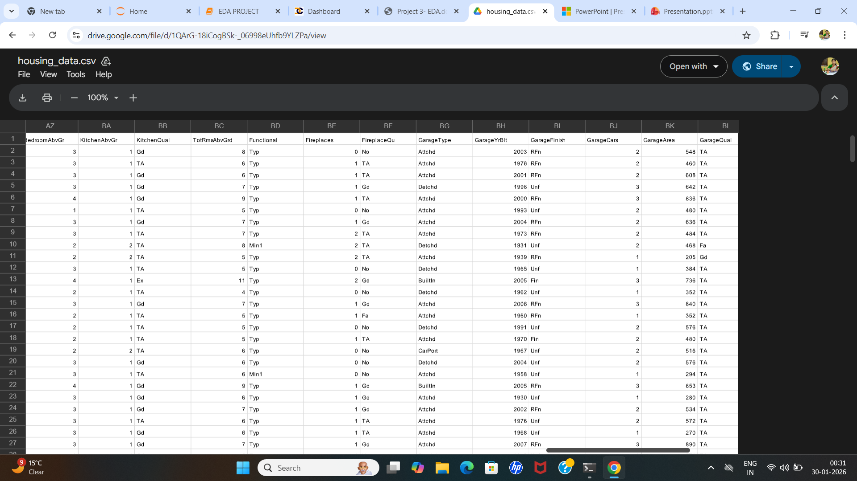
EXPLORATORY DATA ANALYSIS
EXPLORATORY DATA ANALYSIS IS A KEY STEP IN DATA ANALYSIS WHERE WE INVESTIGATE DATASETS TO UNCOVER PATTERNS,ANOMALIES AND INSIGHTS BEFORE MODELING.
IT IS THE FOUNDATION FOR PROJECTS LIKE ANALYZING SALES TRENDS,CUSTOMER CHURN,OR COVID DATA USING TOOLS LIKE PYTHON ALONG WITH PANDAS,NUMPY,MATPLOTLIB ETC.
WE HAVE GIVEN A HOUSING PRICE DATA UPON WHICH THE ANALYSIS HAVE BEEN DONE.

Slide 3
PROJECT OVERVIEW
The real estate industry is inherently complex, influenced by numerous factors that collectively impact the pricing of residential properties. The task at hand is to navigate through this complexity and extract meaningful insights from the available data. As an analytics professional, you are entrusted with the responsibility to not only identify the key variables affecting house prices but also to provide actionable recommendations based on your findings.
The dataset at our disposal comprises diverse parameters such as location, size, amenities, market trends, economic indicators, and historical transaction data. These variables contribute to the intricate web of pricing dynamics, and our role is to unravel their interdependencies through meticulous analysis.

Slide 4
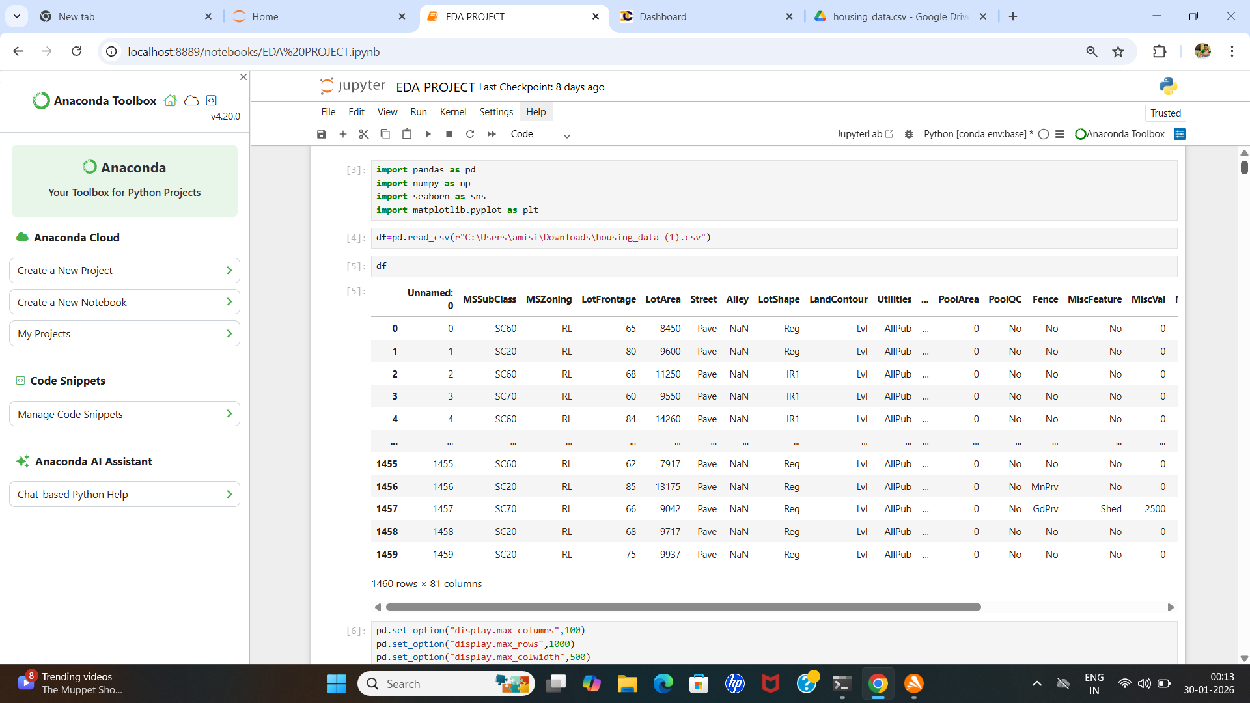
PROCESS
I HAVE DONE THE UNDERLYING PROCESSES ON THE GIVEN DATASET
STEP 1: LOADING THE DATA SET
STEP 2: LOADING THE LIBRARIES SUCH AS PANDAS,SEABORN,MATPLOTLIB ON JUPYTER

Slide 5
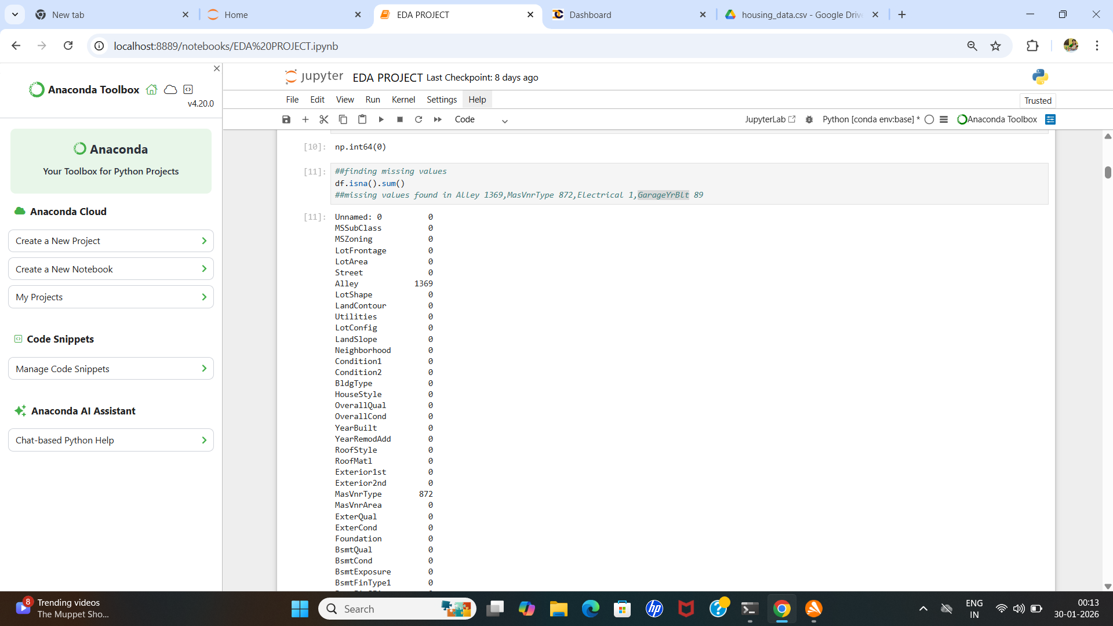
PROCESS

Slide 6
PROCESS
STEP 3: THEN I HAVE CHECKED IF THRE IS ANY DUPLICATE OR MISSING VALUES
THERE WAS NO DUPLICATES
BUT THERE WAS SOME MISSING VALUES AT -
1.ALLEY 1369,
2.MASVNRTYPE872,
3. ELECTRICAL 1,
4.GARAGEYRBLT 89,

Slide 7
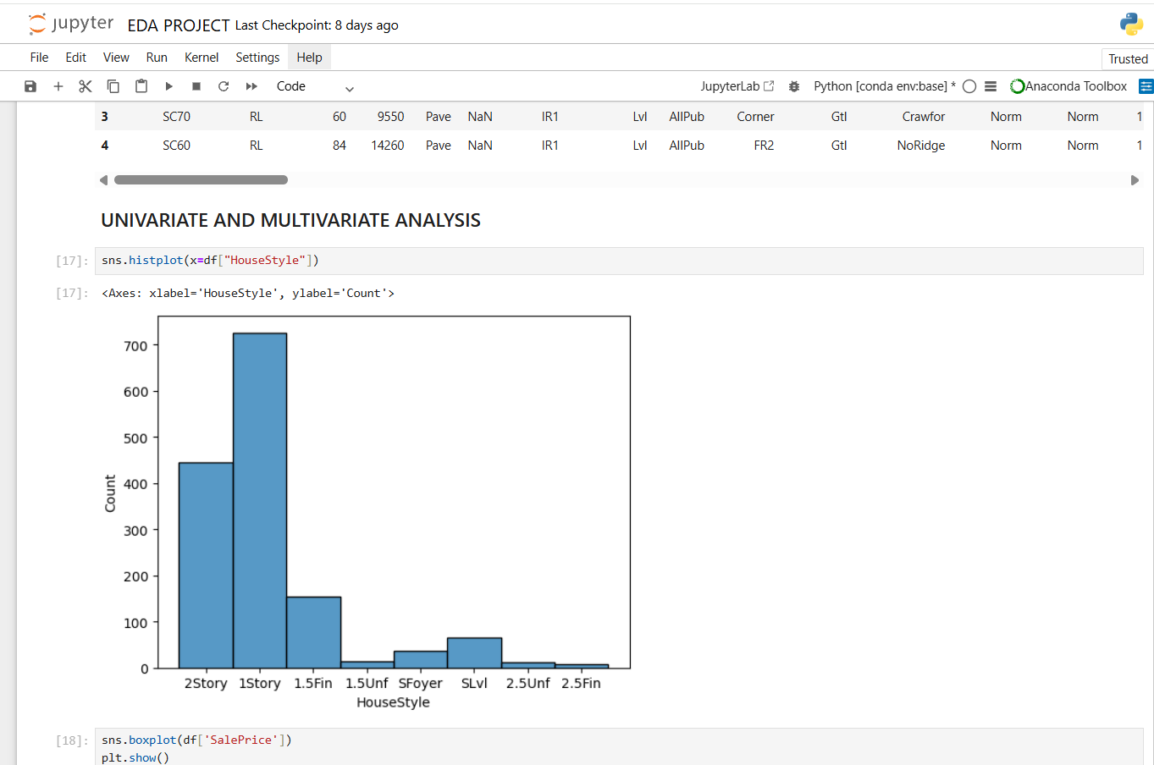
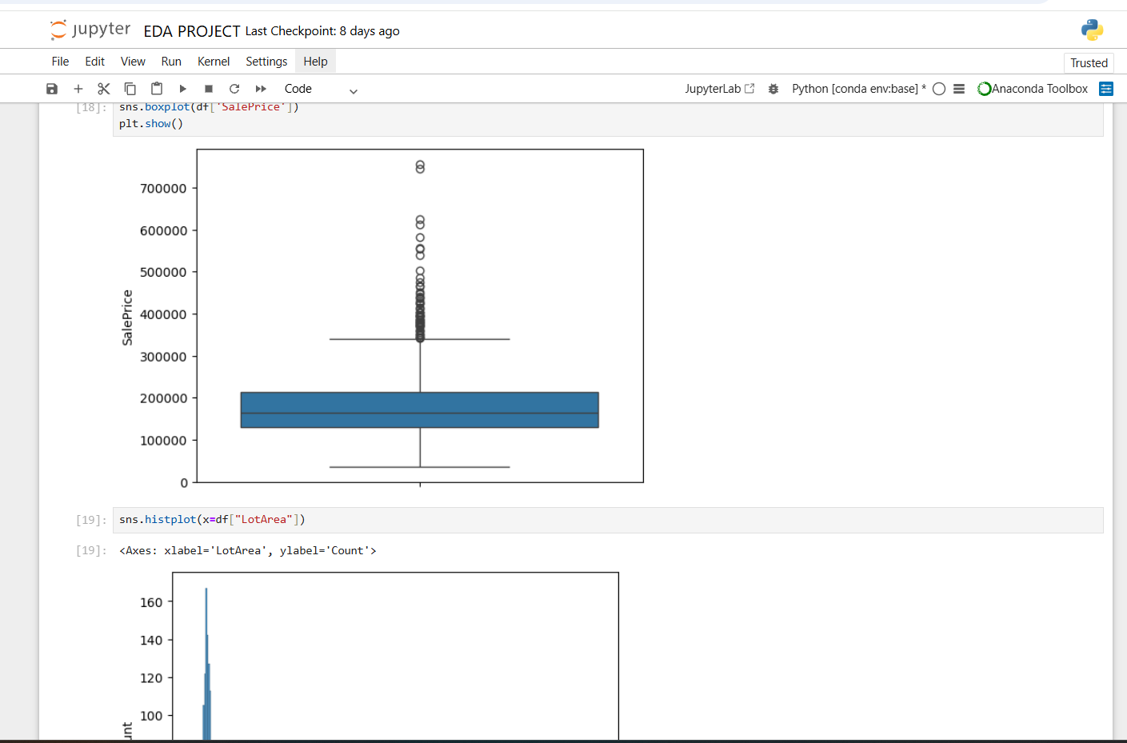
PROCESS
AFTER THOSE INITIAL PROCESSES I HAVE DONE "UNIVARIATE AND MULTIVARIATE ANALYSIS WHICH HELPS US REALIZE TO UNDERSTAND THE DISTRIBUTION OF KEY VARIABLES LIKE HOUSE PRICES. UTILIZE HISTOGRAMS, KERNEL DENSITY PLOTS, OR OTHER VISUALIZATIONS TO GAIN INSIGHTS INTO THE DATA

Slide 8
UTILIZATION OF THE PROCESS
I HAVE INVESTIGATE RELATIONSHIPS BETWEEN MULTIPLE VARIABLES, ESPECIALLY THOSE IMPACTING HOUSE PRICES. I PERFORM MULTIVARIATE ANALYSIS TO UNDERSTAND THE CORRELATIONS AND DEPENDENCIES BETWEEN VARIOUS FEATURES.

Slide 9
PROCESS
THEN I PERFORMED SOME OF THE STATISTICAL TEST ON SALEPRICE ON THE BASIS OF OVERALL QUALITY AND FOUND THAT SALEPRICE IS DIFFERENT FOR DIFFERENT OVERALL QUALITY
AFTER THAT THE MISSING VALUE TREATMENT HAS BEEN DONE ON THE DATASET,THE MISSING VALUES I HAVE MENTIONED EARLIER
NEXT STEP IS OUTLIER TREATMENT

Slide 10
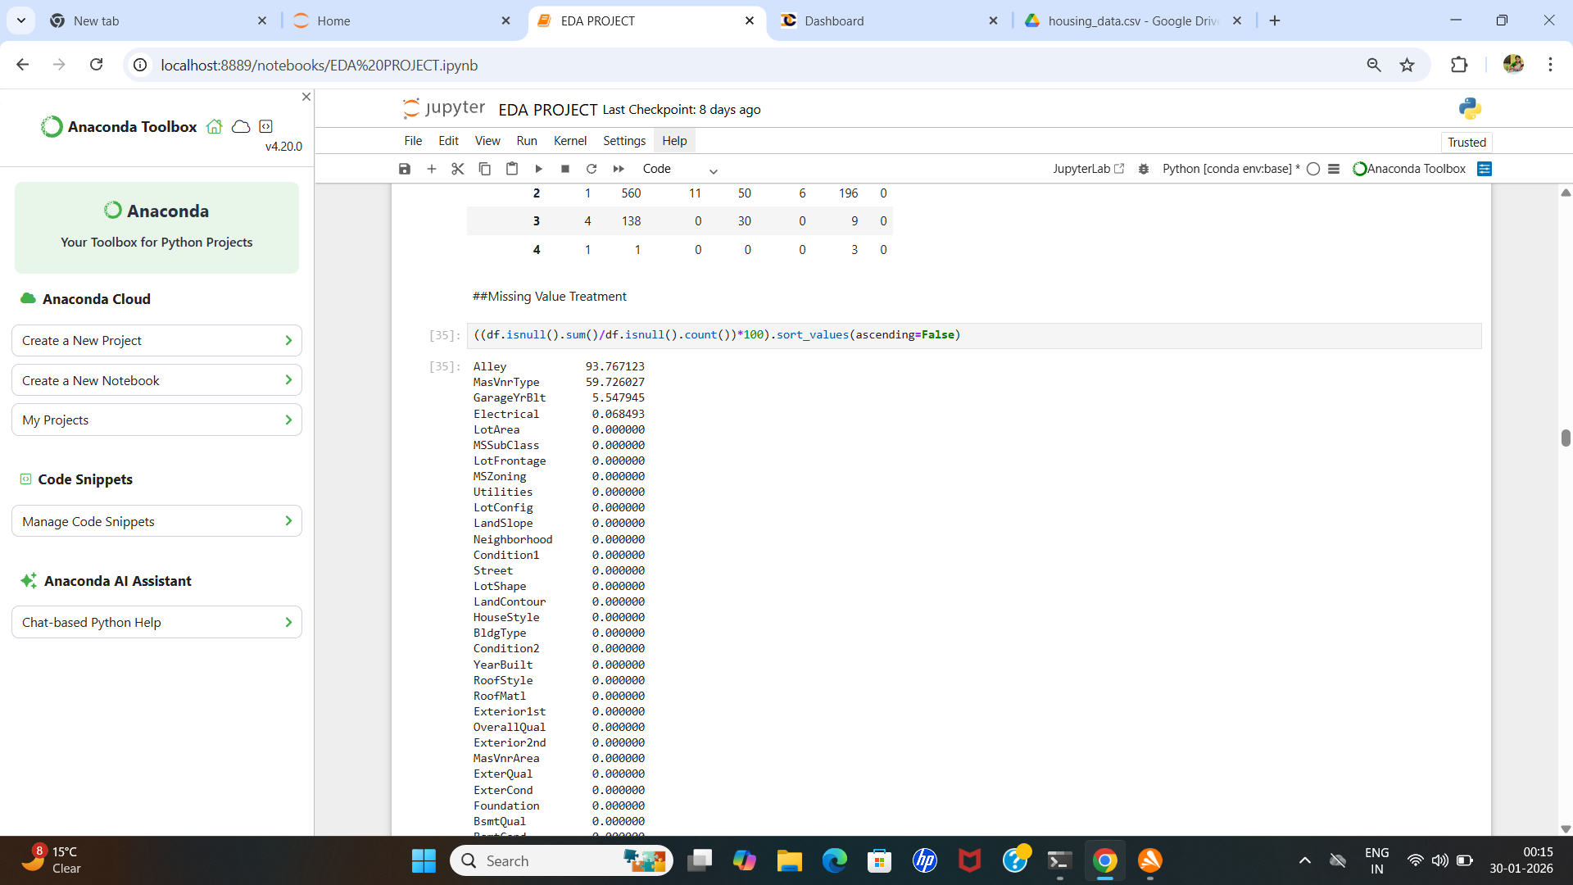
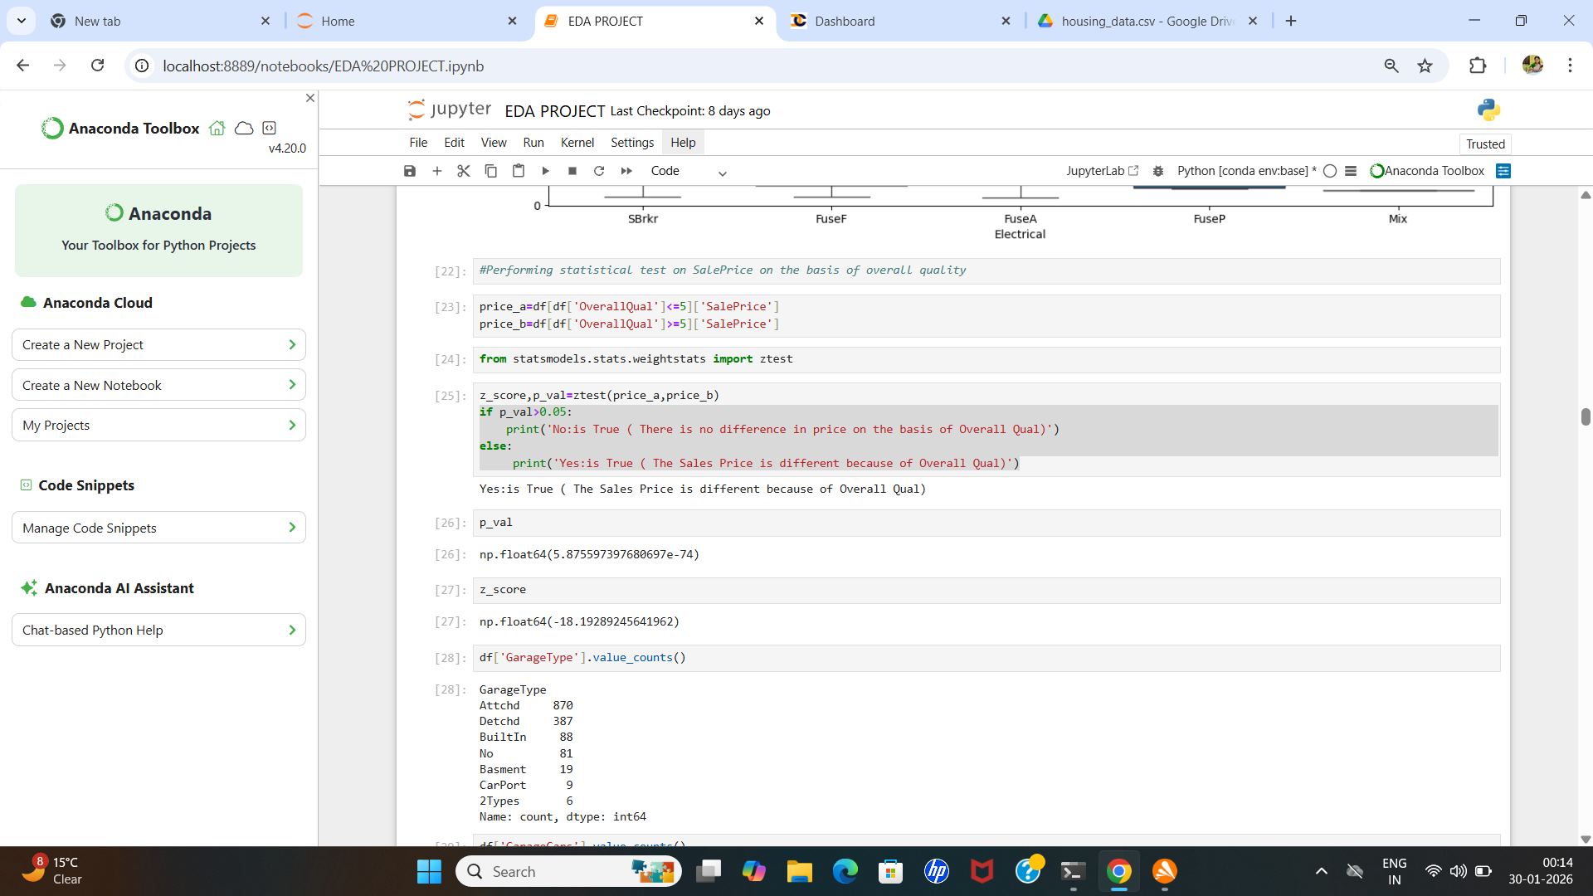
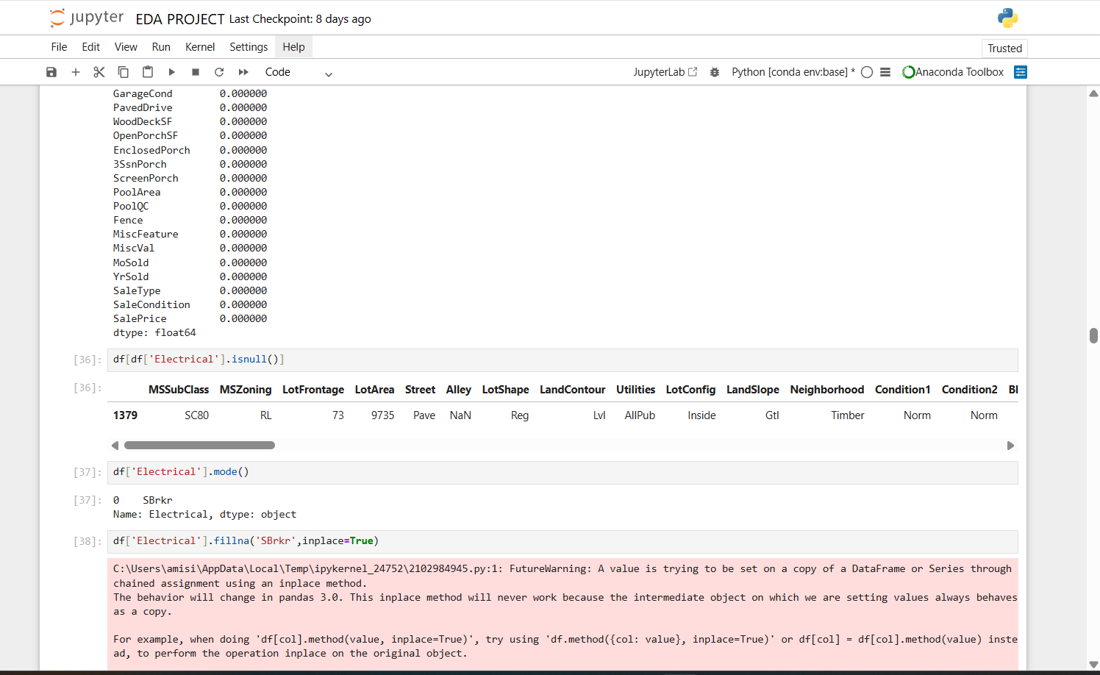
PROCESS

Slide 11
PROCESS
FINALLY OUR DATASET IS READY FOR FEATURE SELECTION AND PERFORMING FEATURE ENGINEERING
THEN MACHINE LEARNING MODELS APPLIED ON DATASET
TRAIN TEST SPLIT AND LINEAR REGRESSION MODEL ALSO BEEN APPLIED
FINALLY WE GOT A MODEL THAT CAN PREDICT THE VALUE OF A HOUSING PROPERTY AND THE MODEL PERFORMS WELL WITH THE DATA.

Slide 12
CONCLUSION
ANALYZING THE DATASET TEMPORALLY, LOOKING AT TRENDS IN HOUSE PRICES OVER DIFFERENT PERIODS,UNDERSTANDING HOW EXTERNAL FACTORS, SUCH AS ECONOMIC INDICATORS, MAY HAVE INFLUENCED THESE TRENDS I HAVE MADE A TABLE HOW THE AVAILABLE AMENITIES AFFECT THE MARKET TREND AND THE SALEPRICE. AMENITIES SUCH AS ,
POOL AREA,
GARAGE AREA,
OVERALL CONDITION,
YEAR BUILT, DIRECTLY AFFECT THE SALE PRICE AND CUSTOMER PREFERENCE.

Slide 13
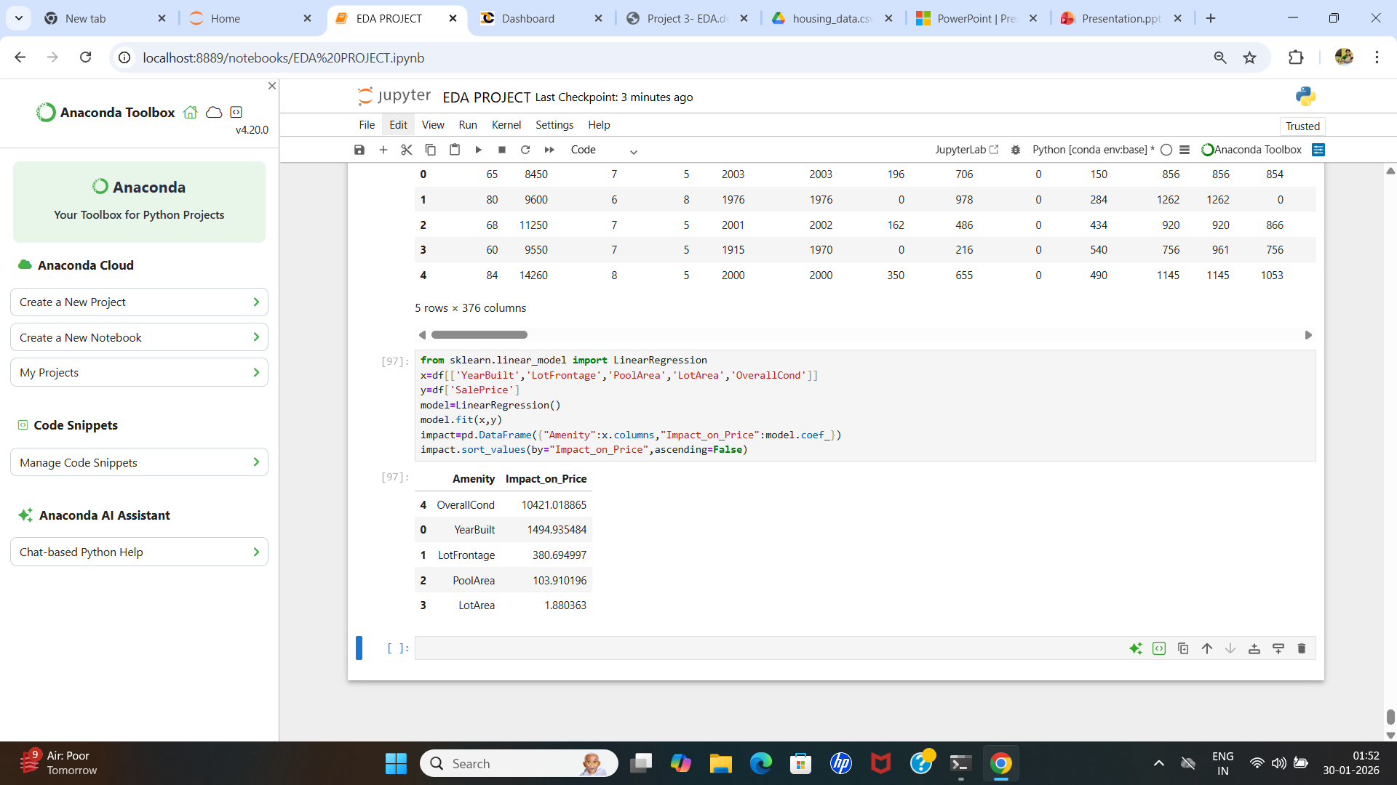
CONCLUSION

Slide 14
THANK YOU
END OF PPT

